Slide 1
SOEN 384
Management, Measurement and Quality Control http://users.encs.concordia.ca/~s384_2/
Lecture 25:
Review for the Final Exam and Exercises

Slide 2
Course Topics by Areas
Part I: Software Measurement
Part II: Software Project Management
Part III: Agile Estimating and Planning.
soen384-F15-L25: review final

Slide 3
Final Exam Coverage
Lecture 16-26
Management Key Area 1: Initiation and scope definition.
Management Key Area 2: Project Planning
Management Key Area 3: Monitor & Control
Agile estimating and planning (A3)
  Re-estimating and re-planning – updated sungraph
soen384-F15-L25: review final

Slide 4
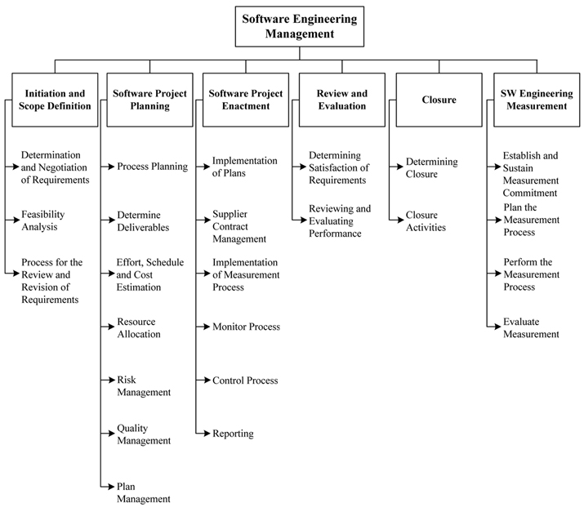
BREAKDOWN OF TOPICS FOR SOFTWARE ENGINEERING MANAGEMENT: SWEBOK
soen384-F15-L25: review final
Notes:
Primary basis for the top-level breakdown is the process of managing a software engineering project.

Slide 5
Management Key Area (KA) 1: Initiation and scope definition.
1.1. Determination and Negotiation of Requirements
1.2. Feasibility Analysis using Project Scope Ratio formula
1.3. Process for the Review and Revision of Requirements
soen384-F15-L25: review final

Slide 6
KA2: Project Activities Planning and Scheduling
2.1 Process Planning
2.3. Effort, Schedule, and Cost Estimation
  Schedule Development: Gantt Charts and Critical Path method.
  Schedule and Resource Allocation
soen384-F15-L25: review final

Slide 7
2.1 Process Planning
project's high-level schedule and organization structure:
  Selection of the appropriate software life cycle
  adaptation and deployment of appropriate software life cycle processes
  Decomposition of the project into tasks/activities, with associated inputs, outputs, and completion conditions
    (for example, work breakdown structure)
soen384-F15-L25: review final

Slide 8
SEM – KA 2: 2.3. Effort, Schedule, and Cost Estimation
Based on the breakdown of activities (Work Breakdown Structure)
expected effort required for each activity
Tools and Techniques for Schedule Development
  Gantt Charts and Critical Path method.
Exam question:
When to estimate effort for software project planning?
soen384-F15-L25: review final

Slide 9
Exam question:
When to estimate effort for software project planning?
once the scope is determined, it is essential to estimate the effort & cost of the proposed developments (or candidate solutions), and therefore the feasibility.
soen384-F15-L25: review final

Slide 10
SEM – KA 2: 2.4. Schedule and Resource allocation
Every scheduled task must be assigned to a specific team member and it should have a defined outcome.
The project manager must ensure that the appropriate number of people have been scheduled at any given time.
Exam question:
What are the key objectives of activity scheduling?
soen384-F15-L25: review final

Slide 11
Key Objectives of activity scheduling
Feasibility assessment: Is the project possible within the required resource constraints?
  Example: if the project requires 12 months with 5 people, can it be done in 6 months with twice as many people?
Allocation of resources
  What are the most effective ways of allocating resources to the project? When should resources be available?
Detailed costing (per feature, activity)
soen384-F15-L25: review final

Slide 12
SEM – KA 2:
2.5. Risk Management
Risk identification and analysis (what can go wrong, how and why, and what are the likely consequences )
critical risk assessment (which are the most significant risks in terms of exposure, which can we do something about in terms of leverage),
risk mitigation and contingency planning (formulating a strategy to deal with risks and to manage the risk profile)
soen384-F15-L25: review final

Slide 13
ISO/IEC Definitions
risk: The combination of the probability of an event and its negative consequence.
  1—The term “risk” is generally used only when there is at least the possibility of negative consequences.
  2—In some situations, risk arises from the possibility of deviation from the expected outcome or event.
risk category: A class or type of risk (e.g., technical, legal, organizational, safety, economic, engineering cost, schedule).
  NOTE—A risk category is a characterization of a source of risk.
soen384-F15-L25: review final

Slide 14
Risk Management process
Steps:
Risk assessment
    Risk Identification
    Risk analysis
    Risk prioritization
Risk control
    Risk planning and mitigation
    Resolution
    Risk monitoring
soen384-F15-L25: review final

Slide 15
Risk
    Risk management’s goal
    Risk categories
    Qualitative risk analysis
    Quantitative risk analysis
    Risk prioritization
    Risk response planning
    Risk monitoring (Decision tree analysis)
    Risk management plan (ISO/IEC 16085:2006 Annex A)
soen384-F15-L25: review final

Slide 16

Review Risks in Cost Estimation
    Effort estimation risks: examples of risks, mitigation
    study the advantages and disadvantages of each cost estimation method seen in class (source: “Software Cost Estimation Methods: Issues and Guidelines”. )
Source:
soen384-F15-L25: review final

Slide 17
Implement Risk Management as a
Part of Project Management
Jim McDonald, Monmouth University
Software project life cycle is selected.
The project itself is then planned
Detailed effort, schedule, and cost estimation is undertaken.
Detailed risk management is undertaken
Resources are then allocated to tasks
Comprehensive software quality management processes are determined
soen384-F15-L25: review final
Notes:
28
28
28
27
27

Slide 18
RISK MANAGEMENT PLAN
ISO/IEC 16085:2006 Annex A
Sample exam question: list the sections of the risk management plan and give an example for each section
the following sections are required:
  RISK IDENTIFICATION
  RISK QUALIFICATION AND PRIORITIZATION
  RISK MONITORING
  RISK MITIGATION AND AVOIDANCE
soen384-F15-L25: review final

Slide 19
SEM – KA 2: 2.6. Quality Management
Comprehensive software quality management processes are determined as part of the planning process in the form of procedures and responsibilities for software quality assurance, verification and validation, reviews, and audits
Identify Software quality requirements
Apply GQM to establish measurement program
  Specify procedures for measurement data collection and analysis
  Set acceptance criteria for each software quality indicator
  Specify procedures for evaluating project adherence to software quality requirements
Specify SQA ongoing procedures
  technical reviews and inspections or demonstrations of completed functionality
soen384-F15-L25: review final

Slide 20
What is Software Quality Engineering
  The application of a continuous, systematic, disciplined, quantifiable approach to the development and maintenance of quality throughout the whole life cycle of software products and systems; that is, the application of quality engineering to software
©Witold Suryn 2003-2007
<number> of 60
soen384-F15-L25: review final

Slide 21
SWEBOK Ch.8 on Quality
“Quality is defined in terms of pertinent attributes of the specific project and any associated product(s), perhaps in both quantitative and qualitative terms. “
  quality characteristics will have been determined in the specification of detailed software requirements
  Thresholds for adherence to quality are set for each indicator
Procedures relating to ongoing SQA throughout the process and for product (deliverable) verification and validation are also specified at this stage
  technical reviews and inspections
soen384-F15-L25: review final

Slide 22
Project plan: Key Points
A project plan is a model of the process that the project team intends to follow to realize the project objectives.
  It brings together project scope, schedule, budget, estimation, and associated risks.
  It defines the process by which the objectives will be achieved, and the responsibilities in carrying out this process.
  Serves as a contract between the project team members and other stakeholders.
    Forms the basis for project monitoring and control.
soen384-F15-L25: review final

Slide 23
SEM – KA 3: Project Monitoring & Control
  Definition and objective
  Activity Tracking indicators
  ISO 15939 financial performance measurement model
soen384-F15-L25: review final

Slide 24
Software Project Monitoring & Control: Definition and objective
Project Monitoring & Control: use any observed differences between planned and actual values of project indicators to evaluate the status of the project and to support decisions to take corrective actions.
  Software Project Plan lists project iterations / milestones
  For each iteration, schedule, effort & quality are estimated before the iteration starts.
  For each iteration, schedule, effort & quality actuals are collected at the end of the iteration.
  If the actual deviates from the estimated by more than the limit specified in the plan at that iteration, then this fact is brought to the knowledge of project manager/ leader & a corrective action is initiated.
Notes:
Once a manager has the ability to track actual project measures against planning estimates, he or she can begin to use any observed differences to evaluate the status of the project and to support decisions to take corrective actions.

Slide 25
Activity Tracking indicators
  Planned Value (PV): for a given task, PV is defined as the effort planned for that task translated into cost.
  Earned Value (EV): % of PV of the work actually completed by a given point in time on the project schedule.
  Actual Cost (AC) (previously called Actual Cost of Work Performed - ACWP):
  The total of costs on tasks that have actually been completed by a given point in time on the project schedule.
soen384-F15-L25: review final

Slide 26
Key questions answered by earned-value analysis
We monitor past performance to control the future performance
PAST PRESENT FUTURE
Are we on schedule?
Are we on cost?
What are the significant variances?
What is the trend to date?
When will we finish?
What will it cost at the end?
How can we control the trend?
The Two Key Questions
1. Did we get what we wanted for what we spent?
2. At the end of the project, is it likely that the cost will be less than or equal to the original estimate?
soen384-F15-L25: review final

Slide 27
Performance indicators
Are we on schedule?
Are we on cost?
What are the significant variances?
What is the trend to date?
  Planned Value (PV): for a given task, PV is defined as the effort planned for that task translated into cost.
  Budget at completion (BAC): sum of all planned value for ALL project’s or iteration’s tasks
  Earned Value (EV): % of PV of the work actually completed by a given point in time on the project schedule.
  Actual Cost (AC) (previously called Actual Cost of Work Performed - ACWP):The total of costs on tasks that have actually been completed and reported in EV by a given point in time on the project schedule.
soen384-F15-L25: review final

Slide 28
Monitoring and Control: Activity Tracking indicators
The values for PV, AC and EV are used in combination to provide measures of whether or not work is being accomplished as planned.
Cost Variance (CV): EV – AC
Schedule Variance (SV): = EV – PV
Cost Performance Index (CPI): EV / AC
Schedule Performance Index (SPI): EV / PV
Are we on schedule?
Are we on cost?
What are the significant variances?
What is the trend to date?
soen384-F15-L25: review final

Slide 29




More Performance indicators (cont.)
The values for PV, AC and EV are used in combination to provide measures of whether or not work is being accomplished as planned.
Percent scheduled for completion
Percent complete
estimate at completion (EAC)
Estimate to complete (ETC)
When will we finish?
What will it cost at the end?
How can we control the trend?
soen384-F15-L25: review final

Slide 30
ISO15939:
Financial Performance Example
Goal:
    The decision-maker in this example needs to assess the ability of the project to complete scheduled activities on time and within cost.
Information Need: determine if the project will complete scheduled activities on time and within cost.
Measurable concept:
    Financial performance
soen384-F15-L25: review final

Slide 31
Financial Performance Example: Activity Tracking by milestone
Questions: What are the cost performance and the schedule performance?
Measures collected for every WBS activity:
  Planned Value PV
  Earned Value EV
  Actual Cost AC
soen384-F15-L25: review final

Slide 32
Indicator 1:
Cost Performance Index (CPI)
Measurement function:
  Cost Performance Index (CPI) = EV / AC
  A ratio of the earned value over the actual cost of completed work
Analysis Model (Interpretation):
  CPI value close to 1.0: Provides a strong indication that the project is within its defined budget.
  CPI value < 1: Cost of completing the work is higher than planned.
  CPI value > 1: Cost of completing the work is less than planned.
Decision criteria: CPI should not exceed +-15%
soen384-F15-L25: review final
Notes:
CPI value close to 1.0: Provides a strong indication that the project is within its defined budget.
CPI value < 1: Cost of completing the work is higher than planned.
CPI value > 1: Cost of completing the work is less than planned.

Slide 33
Indicator 2:
Schedule Performance Index (SPI)
Measurement function:
  Schedule Performance Index (SPI) = EV / PV
  Ratio of the earned value over the planned value.
  It indicates the rate of progress: the efficiency with which the project is utilizing scheduled resources.
Analysis Model (Interpretation):
  An SPI value close to 1.0 indicates efficient execution of the project schedule.
  SPIs > 1 are favorable.
  SPIs < 1 are not favorable.
Decision criteria: SPI should not exceed +-15%
soen384-F15-L25: review final
Notes:
An SPI value close to 1.0 indicates efficient execution of the project schedule.
SPIs > 1 are favorable.
SPIs < 1 are not favorable

Slide 34
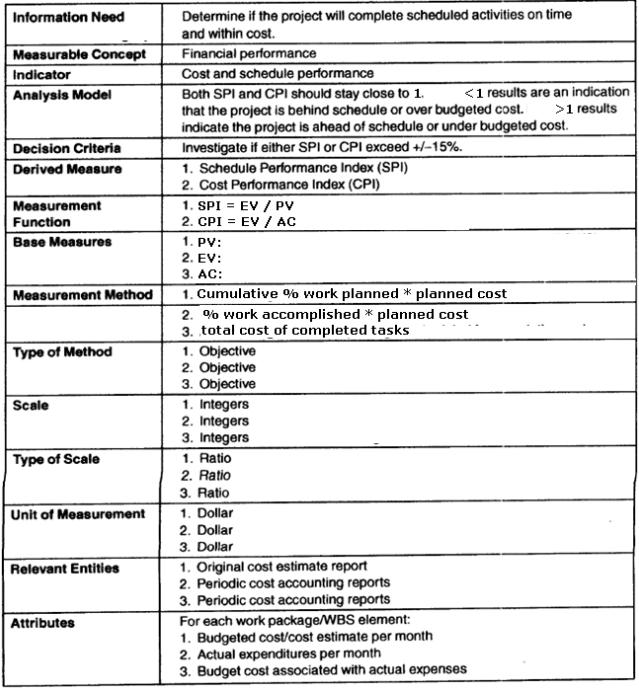
Financial Performance Measurement Plan Documentation: ISO 15939 template
soen384-F15-L25: review final

Slide 35
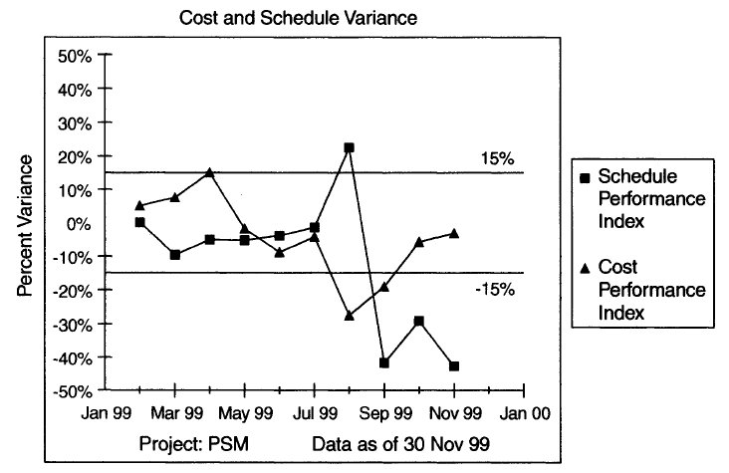
Financial Performance Indicators: SPI and CPI trends
soen384-F15-L25: review final

Slide 36
Agile Estimation and Planning
  Agile principles
  Planning levels in Agile projects
  User stories backlog (release, iteration)
  How to estimate user stories size in story points
  Notion of velocity
  How to plan iterations and determine your team’s initial rate of progress (velocity)
  How to schedule projects that have unusually high uncertainty or schedule-related risk
  Agile tracking and communicating
    Monitoring the release plan
    Monitoring the iteration plan
    Communicating about plans
  Agile estimating and planning workshop

Slide 37
CEAB graduate attributes’ Learning Objectives
Graduate attributes are skills that have been identified by the Canadian Engineering Accreditation Board (CEAB) and the Canadian Information Processing Society (CIPS) as being central to the formation of Engineers, computer scientists and information technology professionals.
Soen384 covered the following graduate attributes:
  Knowledge-base
  Investigation
  Use of engineering tools
  Communication skills
  Economics and project management
  Ethics and equity
  Professional practice
soen384-F15-L25: review final

Slide 38
CEAB Economics and project management, Project planning and implementation
  Identify root causes of project failure (GQM)
  Measure and analyze project quality.
  Quality assurance and control.
  Determine customer satisfaction.
  Develop work breakdown structure.
  Develop project schedules.
  Identify critical paths.
  Identify and manage risk.
  Build teams and manage team dynamics (Agile)
  Use active risk mitigation strategies.
  Adjust schedule of tasks and resources.
  Calculate earned value.
  Monitor budget and schedule.
soen384-F15-L25: review final

Slide 39
Knowledge-base
Knowledge-base in a specific domain
This attribute evaluates student competence in engineering fundamentals in software project management, measurement and quality control.
soen384-F15-L25: review final

Slide 40
Investigation
Definition:
  an ability to conduct investigations of complex problems by methods that include appropriate experiments, analysis and interpretation of data, and synthesis of information in order to reach valid conclusions.
  Use proper methods to define the right measurement program (GQM)
  Use objective data collection procedures
  Use meaningful statistics to analyze and interpret data.
  Synthesize information as indicators to arrive at substantiated conclusions and decision-making
soen384-F15-L25: review final
Notes:
Evaluation:

Slide 41
Use of engineering tools
Definition:
  Demonstrate appropriate operational use of tools (e.g. software) for specific tasks in a laboratory environment.
Exam question:
  What tools have you used in this course?
soen384-F15-L25: review final

Slide 42
Written Communication skills
Organize information appropriately for readers’ use
Use correct language and diagrams to clearly and efficiently convey complex information
Use of appropriate templates and documentation standards
soen384-F15-L25: review final

Slide 43
Ethics and equity
Identify duties and obligations in the Professional/Engineer’s code
Exam question:
  List two Professional/Engineer’s duties and obligations
soen384-F15-L25: review final

Slide 44
Professionalism:
Definition: An understanding of the roles and responsibilities of the professional engineer in society, especially the primary role of protection of the public and the public interest.
Exam question:
  List relevant standards covered in the course
soen384-F15-L25: review final

Slide 45
Exercises
Review Tutorials
next
soen384-F15-L25: review final

Slide 46
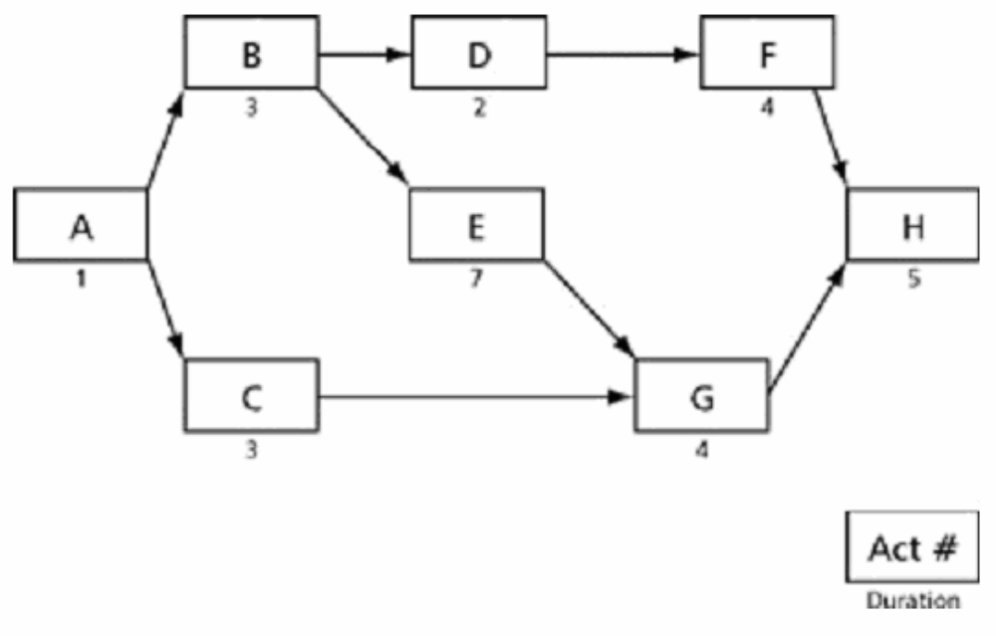
1- A schedule was developed for a project. The project is given a very high priority, and the contractor has agreed to schedule the work on a single shift basis (8 hours per day) but the team will work seven days per week until the job is done. The project is to begin on May 1 and follow the activity network given in Figure 1. On the activity network, the number below each task corresponds to the number of days that the task would require to complete. Draw the complete Activity-on-Node network and answer the questions:
soen384-F15-L25: review final

Slide 47
1) What is the earliest finish-date for activity D?
2) What is the free float for activity F?
(The free float or slack is the amount of time that an activity can be delayed before it affects the schedule of any other activity.)
3) What is the free float for activity D?
4) What is the critical path of the project?
5) What is the earliest-date that activity F can start?
6) What is the latest date that activity F can start?
7) What is the duration of the project in days?
8) If there is a delay of four days on activity F, what is the effect on the project completion date?
9) What is the earliest-date for the completion of activity A?
soen384-F15-L25: review final

Slide 48
Solution
3
2
4
1
B
4
4
D
6
6
F
10
1
4
9
11
11
15
0
5
5
1
5
7
0
A
1
15
H
20
0
1
4
E
11
15
20
0
4
11
0
0
3
4
1
C
4
11
G
15
8
11
11
15
7
0
soen384-F15-L25: review final

Slide 49
Activity Table
Activity | Duration | ES | EF | LS | LF
A | 1 | 0 | 1 | 0 | 1
B | 3 | 1 | 4 | 1 | 4
C | 3 | 1 | 4 | 8 | 11
D | 2 | 4 | 6 | 9 | 11
E | 7 | 4 | 11 | 4 | 11
F | 4 | 6 | 10 | 11 | 15
G | 4 | 11 | 15 | 11 | 15
H | 5 | 15 | 20 | 15 | 20
soen384-F15-L25: review final

Slide 50
Solution
1) What is the earliest finish-date for activity D? | MAY 6
2) What is the free float for activity F? | 5 Days
3) What is the free float for activity D? | 5 Days
4) What is the critical path of the project? | A B E G H
5) What is the earliest-date that activity F can start? | MAY 7
6) What is the latest date that activity F can start? | MAY 12
7) What is the duration of the project in days? | 20 Days
8) If there is a delay of four days on activity F, what is the effect on the project completion date? | No Change
9) What is the earliest-date for the completion of activity A? | MAY 1
soen384-F15-L25: review final

Slide 51
2- Referring to previous question, suppose that the duration of activity E is shortened to 16 hours. Calculate the end date of project. What would the end date of the project be if activity E were shortened to 1 day? Why?
soen384-F15-L25: review final

Slide 52
Solution
3
2
4
1
B
4
4
D
6
6
F
10
1
4
4
6
6
10
0
0
0
1
5
2
0
A
1
10
H
15
0
1
4
E
6
10
15
0
4
6
0
0
3
4
1
C
4
6
G
10
3
6
6
10
2
0
soen384-F15-L25: review final

Slide 53
Solution
Shortening activity E to 2 days will bring the project completion date to May 15 that is it will save 5 days on the duration of the project. However there are now two critical path, “A-B-D-F-H” and “A-B-E-G-H” , so that reducing the duration of activity E to 1 day will not shorten the project duration.
soen384-F15-L25: review final

Slide 54
3- A project manager is reviewing the work breakdown structure for her project. The WBS for the project represents:
A frame work for budgeting and expenditure tracking.
All the work that must be completed for the project.
The work that must be performed by the project manager.
All the management activities needed for the project.
Answer: b
soen384-F15-L25: review final

Slide 55
4- Which of the following statement is false?
70% of projects are over budget and behind schedule.
Software project scheduling is an activity that distributes estimated effort across the planned project duration by allocating effort to tasks.
Adding people late in a project has positive effect on the project (causing schedules to speed up faster)
An unrealistic deadline established by someone outside the development team is one of the reasons to delay a project.
Answer: c
soen384-F15-L25: review final

Slide 56
5- Name the objectives of activity planning
Feasibility assessment
Resource allocation
Detailed costing
soen384-F15-L25: review final
Notes:
1. have to address the following question: Is the project possible within the required resource constraints? For example, if a project requires 12 months, can it be done in 6 months with twice as
many people?
2. have to coordinate staff and allocate them to resources. What are the most effective ways of allocating resources to the project? When should resources be available?
3. After allocating resources, we can obtain good estimates of costs.

Slide 57
6- What is WBS? What are the motivation behind it? How we can represent it?
WBS is an exhaustive, hierarchical (from general to specific) tree structure of deliverables and tasks that need to be performed to complete a project.
It provides:
  A description of all significant work.
  A clear task decomposition for assignment of responsibilities.
  A framework for scheduling, budgeting, and expenditure tracking.
We can represent it by:
functional responsibilities.
According to life-cycle phases, showing each phase as a top-level breakdown.
soen384-F15-L25: review final

Slide 58
7- Which of the following statements is false regarding activity network?
In activity network, critical path can be identified by joining all activities with Zero float.
Activity network helps to identify when resources will need to be deployed to activities
Float is the measurement of how much the duration of an activity can be minimized.
Assess the feasibility of the planned project completion date
Answer: c
soen384-F15-L25: review final

Slide 59
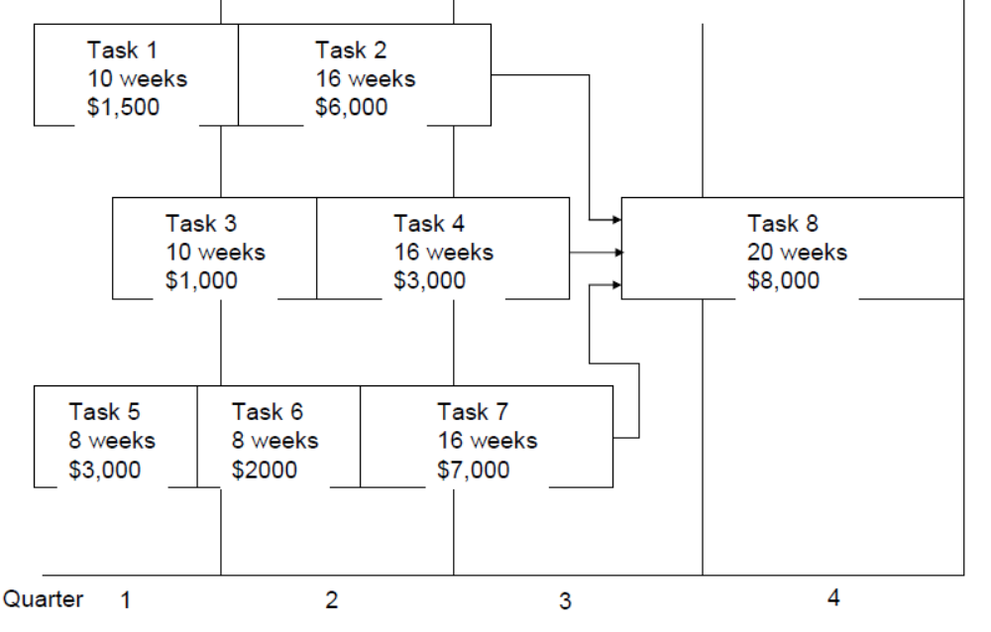
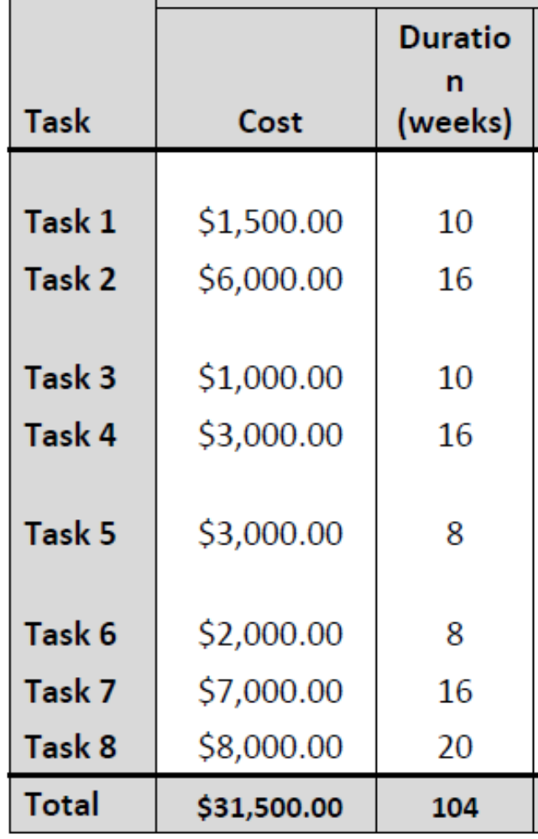
Detailed cost & duration
soen384-F15-L25: review final

Slide 60

Plan
soen384-F15-L25: review final

Slide 61
Example: monitoring & control
soen384-F15-L25: review final

Slide 62
Example: monitoring & control
Planned:
tasks 1, 3, 5, 6 must have been completed.
Task 2 should have been completed by 2/3,
task 4 should have been completed by 40%, and
task 7 should have been completed by 60%.
Actual values:
The project manager reports that tasks 1-6 have been completed as planned,
task 7 is 15% complete,
the amount of money already spent to date is $15,000.
soen384-F15-L25: review final

Slide 63
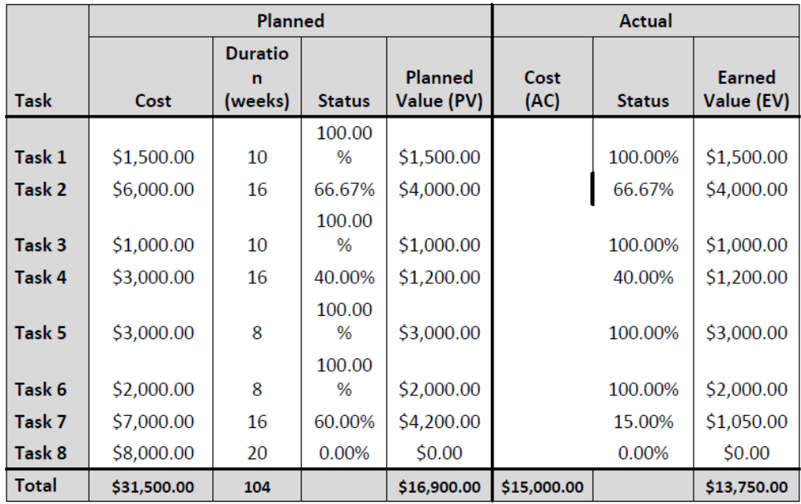
monitoring & control: data collection
soen384-F15-L25: review final

Slide 64
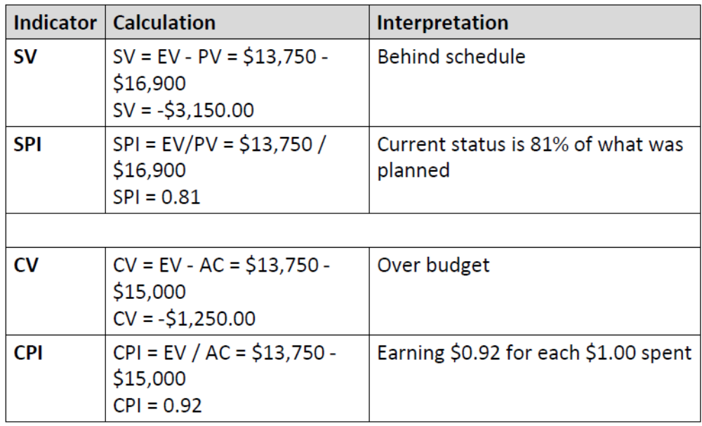
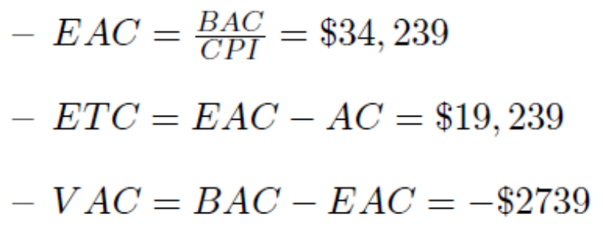
Example: monitoring & control
soen384-F15-L25: review final

Slide 65
Risk categories
Example: Identify the risk category of New equipment failure
  Technology risk
  People risk
  Organizational risk
  Tools risk
  Requirements risk
  Estimation risk
soen384-F15-L25: review final

Slide 66
Risk response planning strategy
Example: Suggest a risk response planning strategy and propose actions to be planned according to the chosen strategy for New equipment failure
  Avoidance
  Transference
  Mitigation
  Acceptance
soen384-F15-L25: review final

Slide 67
Exercise 1: Risk identification & Risk response strategies:
For each project risk item A, B, C listed below
1. identify its category according to the classification seen in class,
2. suggest a risk response planning technique.
Project risk item | Risk category | Suggest a risk response planning technique. Justify your choice.
A. New tool we don’t have enough experience with
B. Volatile requirements
C. Adopting new information management system which does not meet space requirements
soen384-F15-L25: review final

Slide 68
Exercise 1 possible solution
Project risk item | Risk category | Suggest a risk response planning technique. Justify your choice.
A. New tool we don’t have enough experience with | Tools risk | Mitigation: Plan for hiring an expert to train the staff
B. Volatile requirements | Requirements risk | Mitigation: Use prototypes in the development process
C. Adopting new information management system which does not meet space requirements | Technology risk | Avoidance: Adopt another MIS that meets space requirements
soen384-F15-L25: review final

Slide 69
Exercise 2: Risk reduction leverage
Project required the use of a special purpose computer for testing the software that your team is developing. You are not sure that the computer will arrive in time to start testing on schedule.
  Your purchasing department has estimated that there is a 70% probability that delivery will be delayed by 2 months, which will delay your team’s delivery by a comparable amount.
  The contract that you have with the customer reduces the customer’s cost by $200,000 for each month of delivery delay. Therefore, if the computer is delayed by 2 months, your delivery will be delayed 2 months and it will cost you $400,000 in reduced revenues from your customer.
  Your purchasing department has suggested that if you offer the computer vendor a fee of $200,000 for on-time delivery, the probability of a 2-month delay will be reduced to 20%
Should you seriously consider this option?
soen384-F15-L25: review final

Slide 70
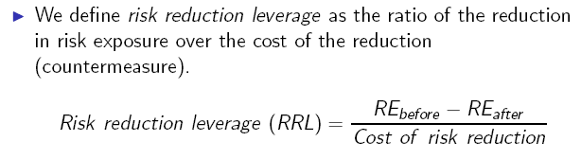
Exercise 2 solution
Solution:
  RRL = (80% * 400,000 – 20% * 400,000) / 200,000 > 1
Conclusion:
  RRL > 1 indicates that this is a cost effective risk measure
soen384-F15-L25: review final

Slide 71
Exercise 3: Decision tree analysis technique
A company is planning a project to develop a new product and has identified 3strategies it can use to bring the product to market – A, B, C. 3 possible states of nature are also identified – a low market demand, an even market demand, and a high market demand.
A payoff matrix with probabilities of each market condition has been developed:
Your task is to advise the decision making committee which one is better. Apply decision tree analysis technique to determine the expected value of each strategy and recommend what strategy the project should take to evaluate.
Strategy | High=30% | Even=40% | Low=30%
A | $65 | $50 | -$20
B | $40 | $25 | $10
C | $30 | $10 | -$5
soen384-F15-L25: review final

Slide 72
Exercise 3: Solution
Expected Monetary Value EMV = Probability_high * Impact_high + Probability_even * Impact_even + Probability_low * Impact_low
Strategy | High=30% | Even=40% | Low=30%
A | $65 | $50 | -$20
B | $40 | $25 | $10
C | $30 | $10 | -$5
EMV (A) = $65 * 30% + $50 * 40% - $20 * 30% = $33.50
EMV (B) = $40 * 30% + $25 * 40% + $10 * 30% = $25
EMV (C) = $30 * 30% + $10 * 40% - $5 * 30% = $11.50
Recommended strategy: A
soen384-F15-L25: review final

Slide 73
Questions?
…
Next: Agile workshop (2)
Final exam on December 22nd
soen384-F15-L25: review final

